Slide 1
Case Study #1 Cyclistic bike-share analysis Dana Anderson November 2024

Slide 2
Agenda
Introduction
Problems
Solutions
Conclusions
Next Steps

Slide 3

Introduction
Cyclistic is a bike ride-sharing business.
The director of marketing believes that the company’s future success depends on maximizing the number of annual memberships.
Therefore, the goal is to understand how casual riders and annual members use Cyclistic bikes differently. From there, the solution will be to design a new marketing strategy to convert casual riders into annual members.
This simulates a real-world scenario of a business wanting to understand their customers better to maximize their profits.
The stakeholders will be the department heads, mainly the marketing department.

Slide 4

Problems
Question to Answer: How do annual members and casual riders use Cyclistic bikes differently?
Business Task: Identify differences between annual members and casual members to create actionable insights which will be used to develop marketing strategies that will convince casual members to become annual members.
Major Problem: identifying differences between the two groups in the vast amount of data

Slide 5
Problems
Approach: The data contains rides made by casual and annual members, particularly the date, time, and location of where each ride started and ended. It also contains what kind of bike was used.
Approach: From this data, I can generate characteristics of ride dates, ride times, ride locations, and bike type for both casual and annual members.
Approach: After generating this data, we can look at the differences between casual and annual members in how their behavior with bikes differs.

Slide 6
Solutions

Slide 7
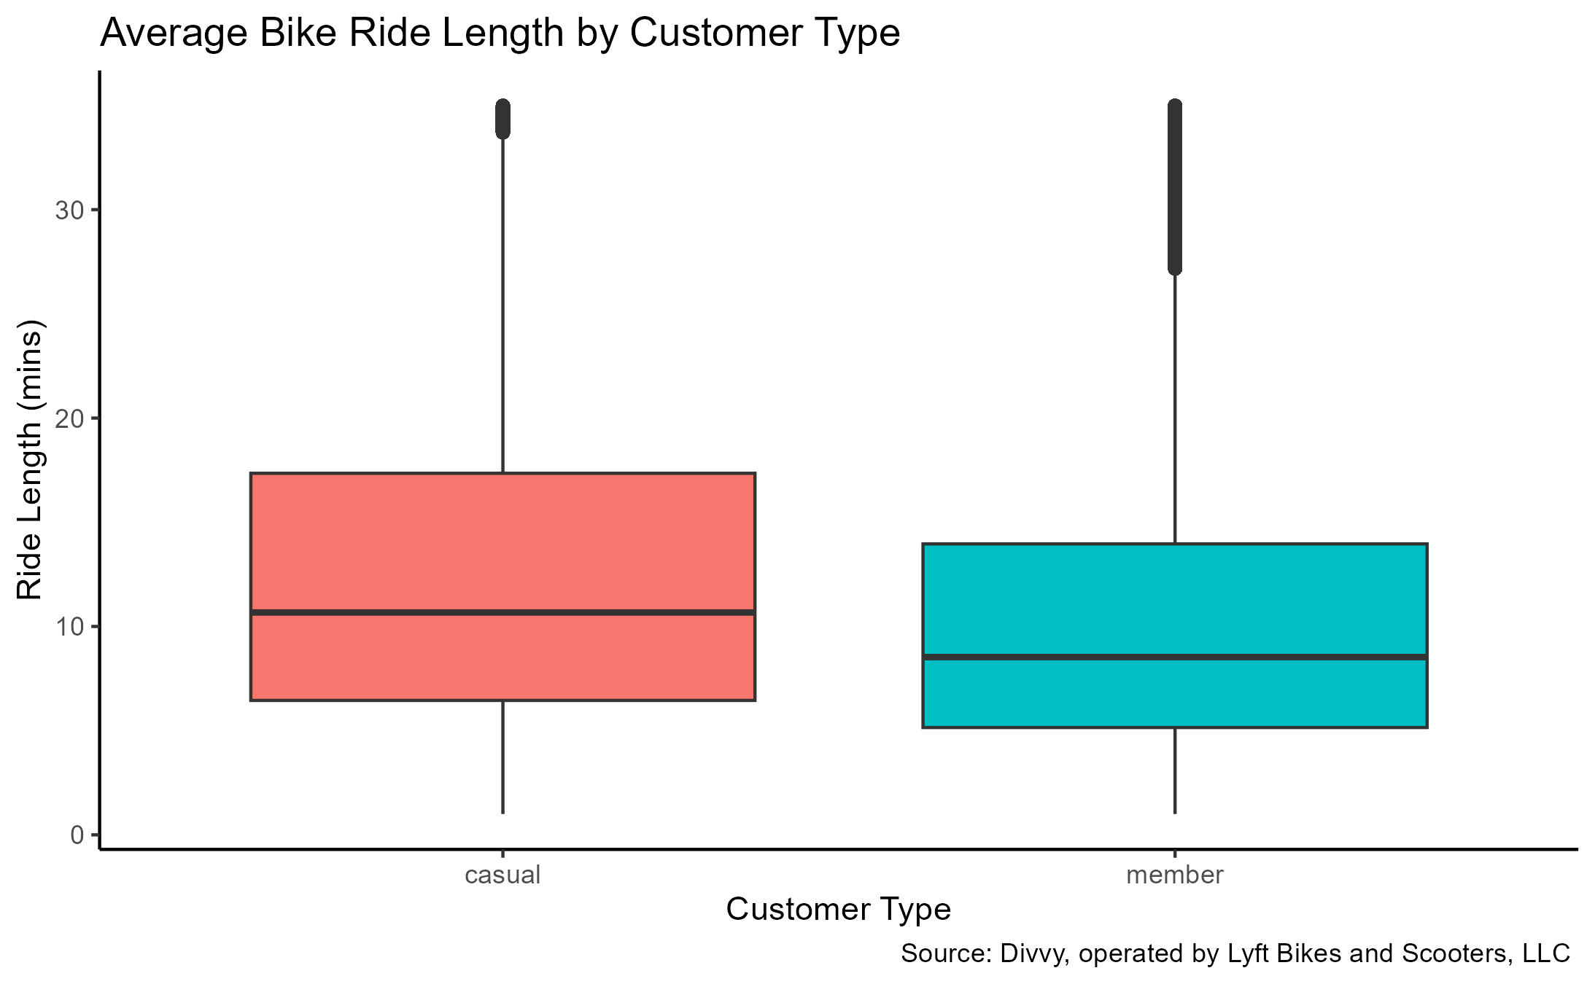
Solution 1 – ride length
Members have lower ride lengths for all three calculations: average, median, and mode ride lengths.
This means that
The average ride length of casual riders is longer.
The middle value of all casual ride lengths is higher.
The most common ride length for casual riders is higher.

Slide 8
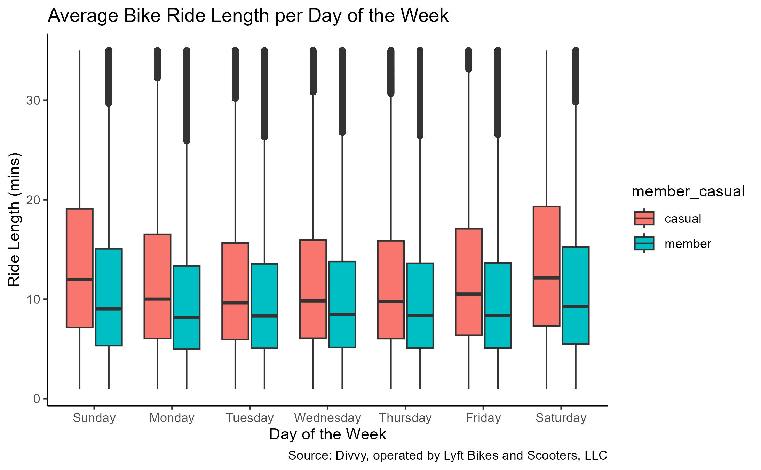
Solution 2 – day of the week
The average ride length per day is longest on Saturday for both casual and member riders.

Slide 9
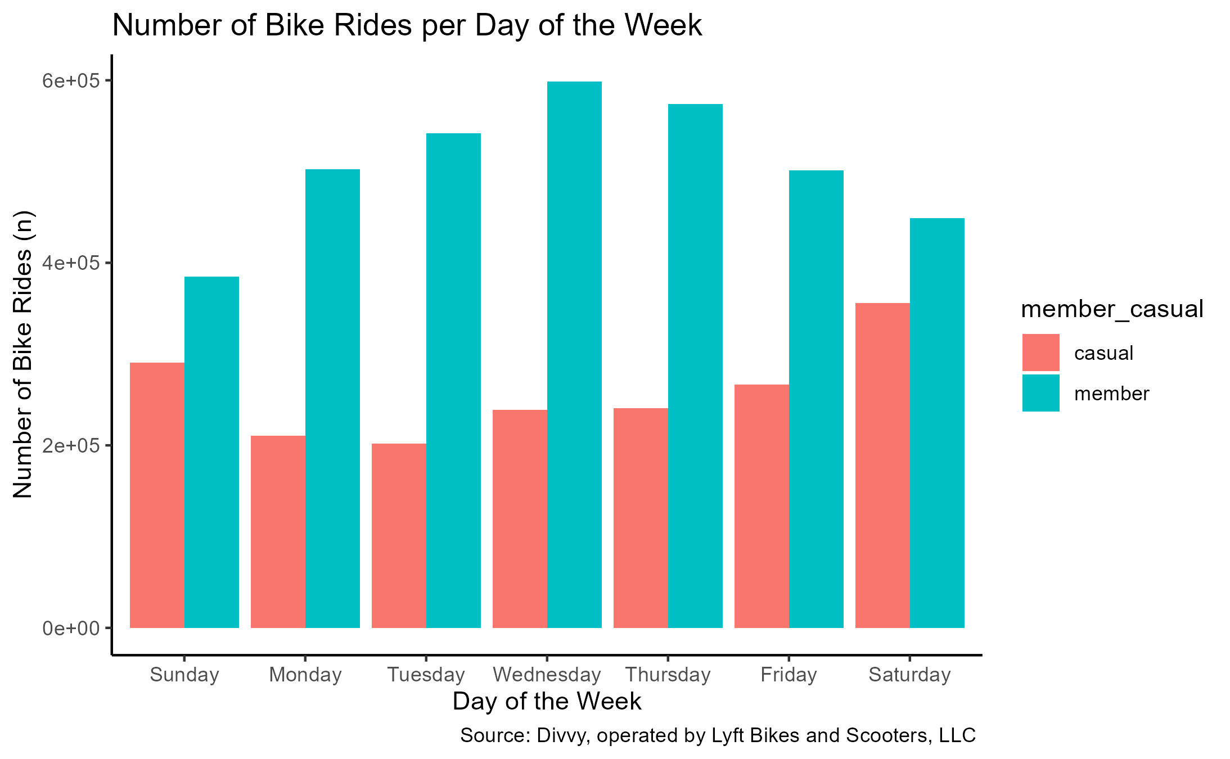
Solution 2 – day of the week
Casual riders ride mostly on Saturdays.
Member riders ride mostly on Wednesdays.

Slide 10
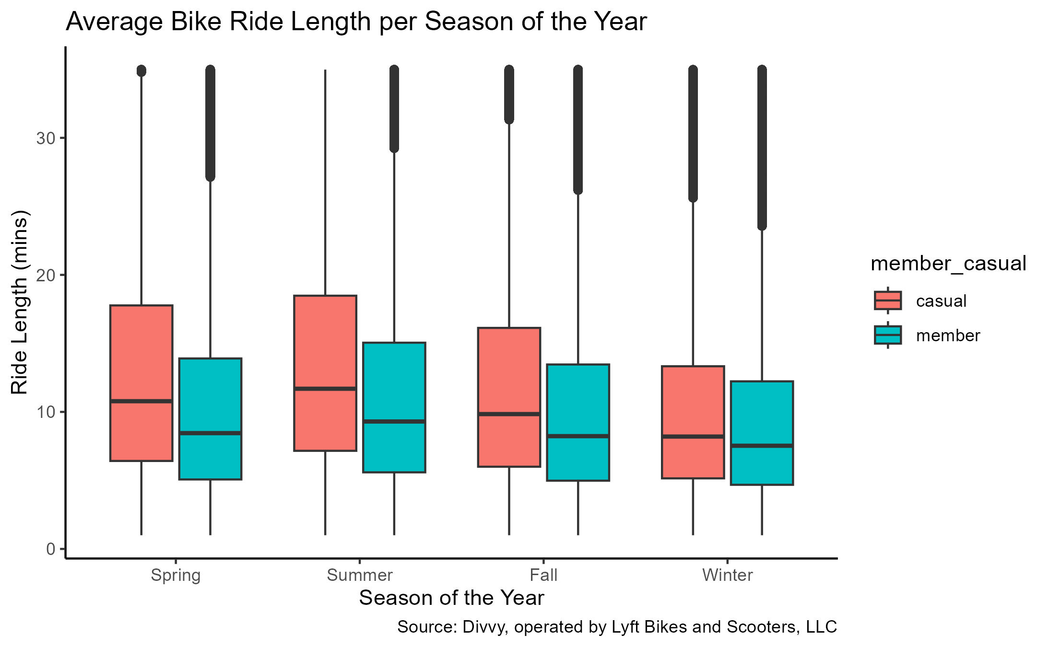
Solution 3 – Season of the year
The average ride length per season for both casual and member riders is longest in summer.
Note – these were the months chosen to represent each season:
Spring (Mar, Apr, May)
Summer (Jun, Jul, Aug)
Fall (Sep, Oct, Nov)
Winter (Dec, Jan, Feb)

Slide 11
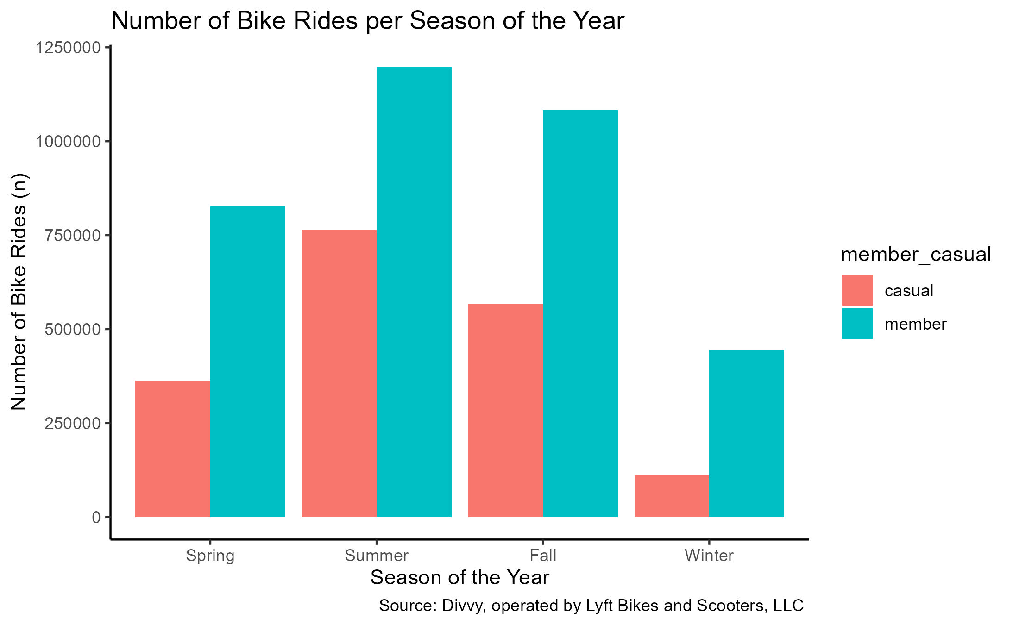
Solution 3 – Season of the year
Both casual and member riders ride mostly in summer.
Note – these were the months chosen to represent each season:
Spring (Mar, Apr, May)
Summer (Jun, Jul, Aug)
Fall (Sep, Oct, Nov)
Winter (Dec, Jan, Feb)

Slide 12
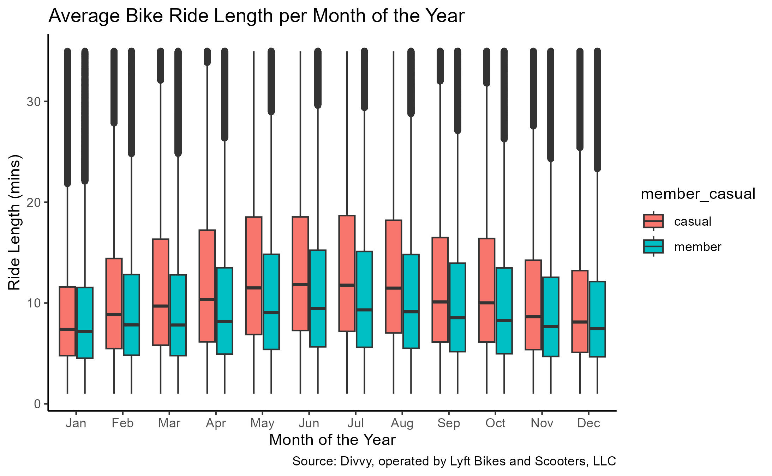
Solution 4 – Month of the year
Casual riders’ average ride length per month is longest in July.
Member riders’ average ride length per month is longest in June.

Slide 13
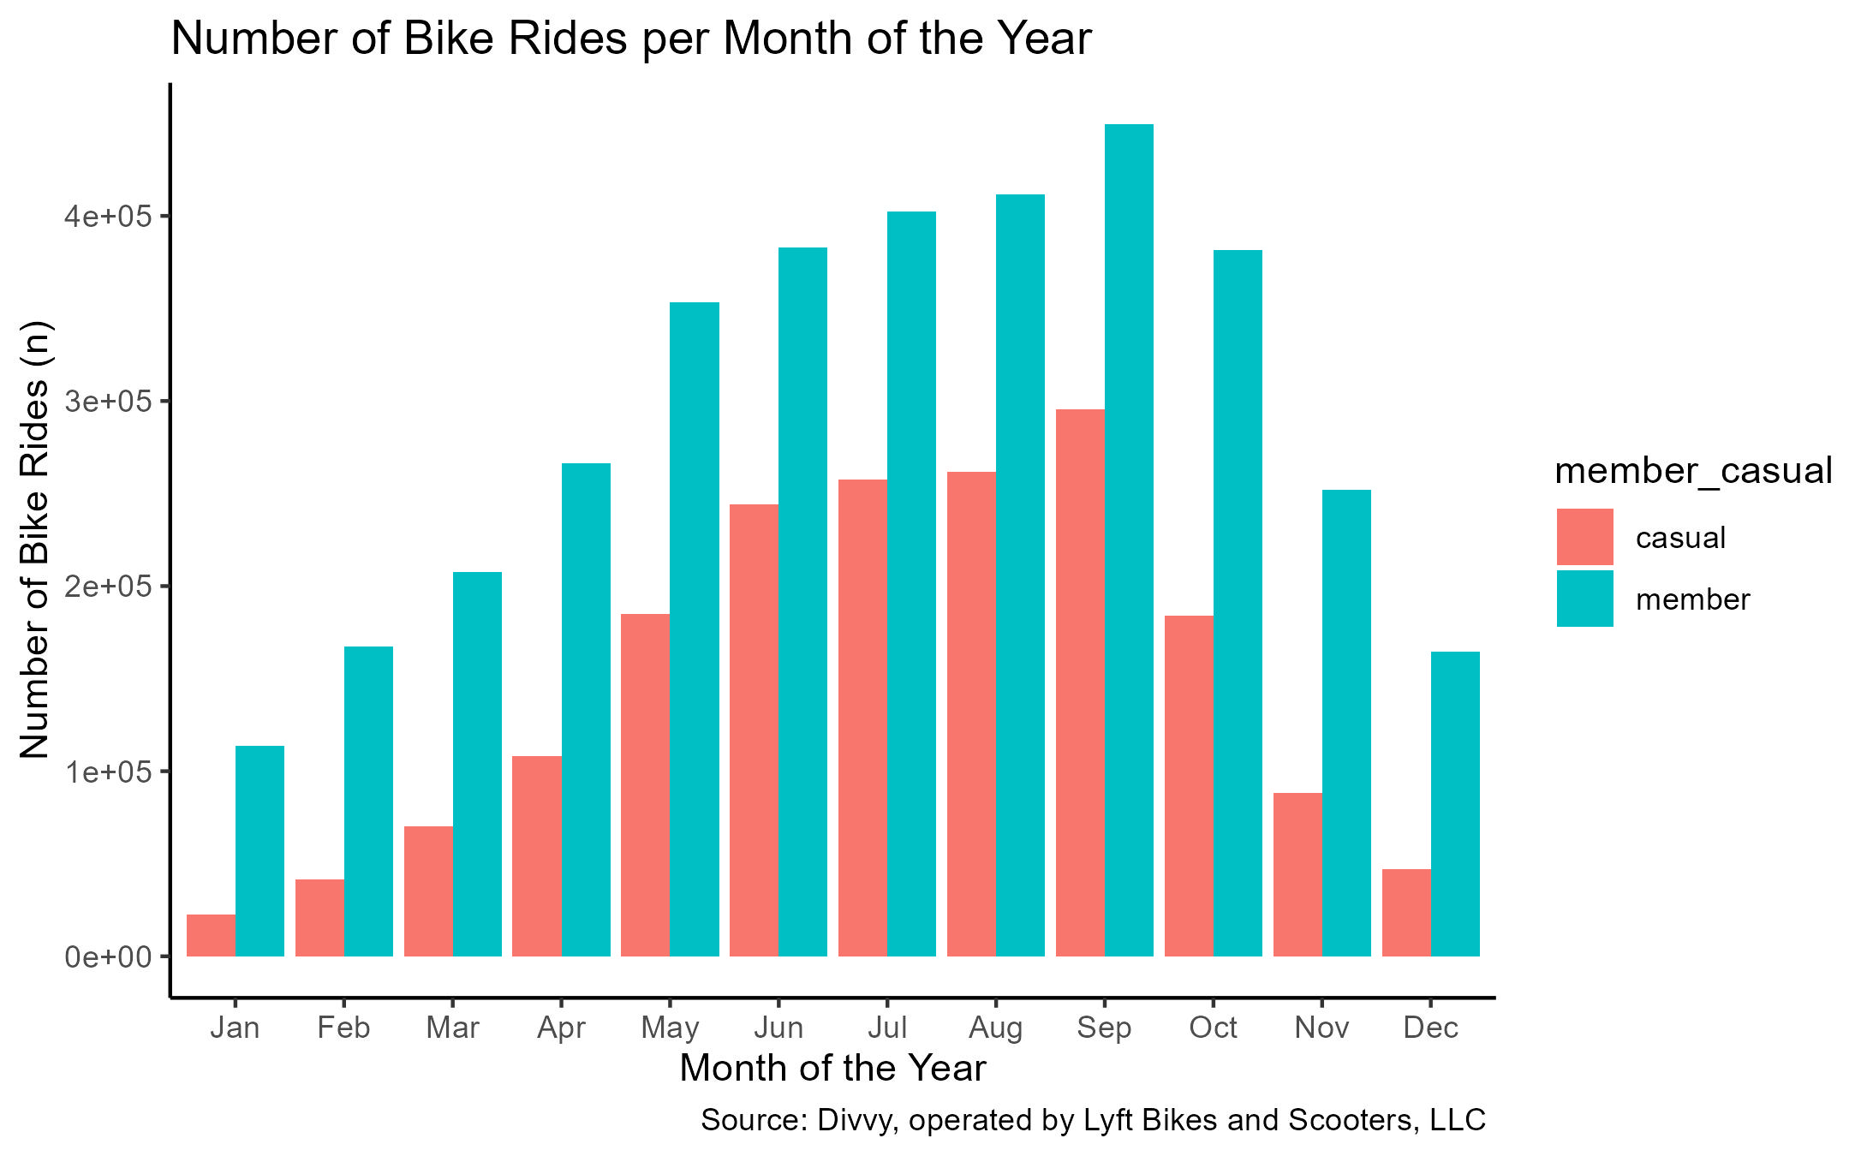
Solution 4 – Month of the year
Both casual riders and member riders ride mostly in September.

Slide 14
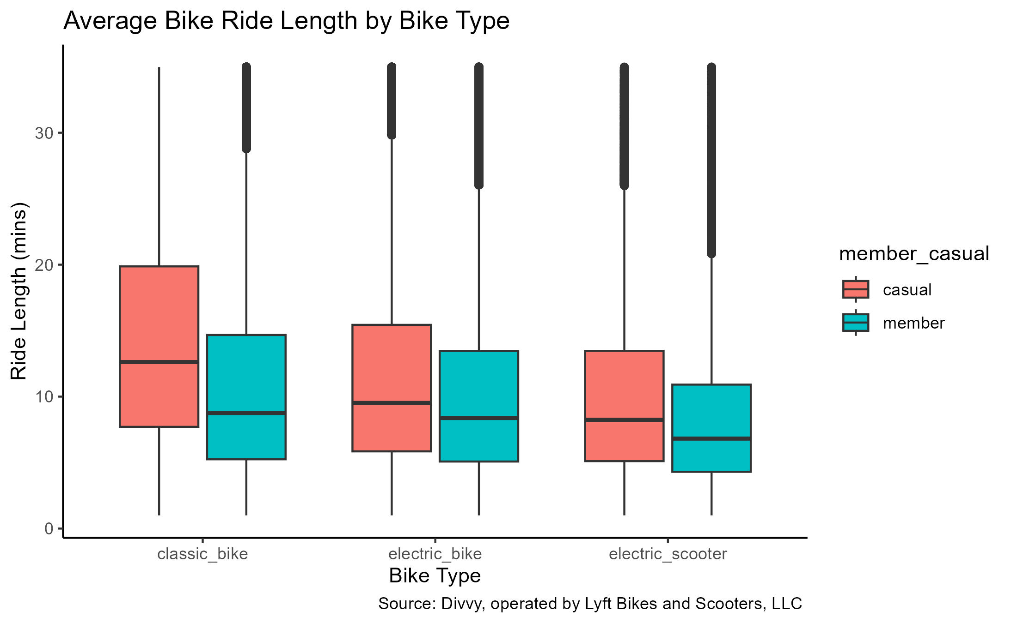
Solution 5 – Bike Type
Both casual and member riders have a higher average ride length with classic bikes over electric bikes and electric scooters.

Slide 15
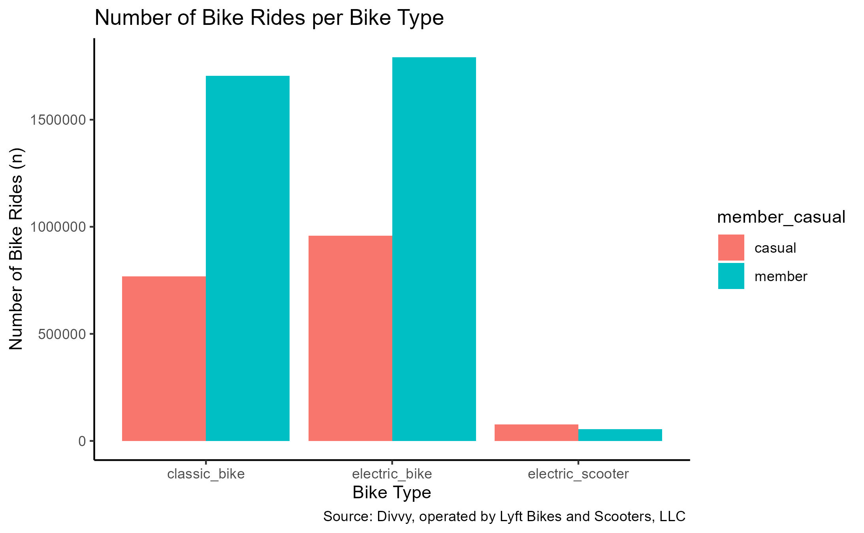
Solution 5 – Bike Type
Both casual and member riders ride more electric bikes than classic bikes or electric scooters.

Slide 16
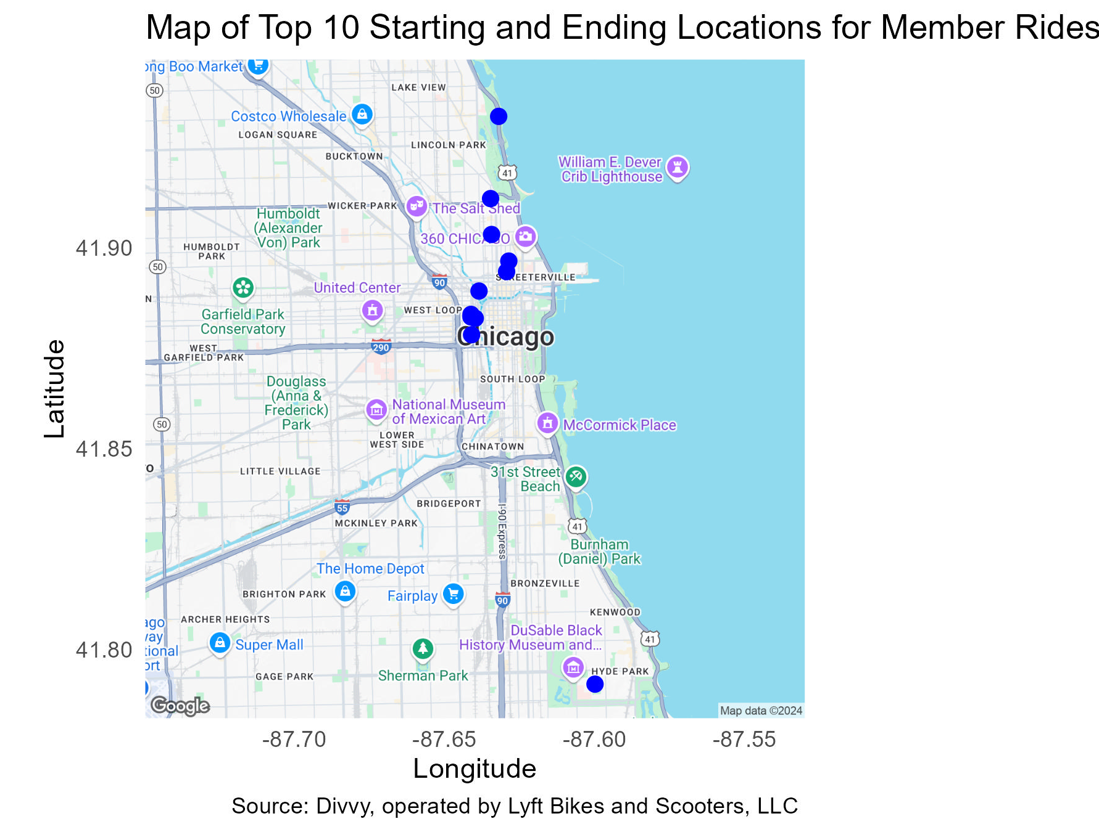
Solution 6 – ride locations (member)
Station Name | Start | End
Kingsbury St & Kinzie St | #1 | #1
Clinton St & Washington Blvd | #2 | #2
Clinton St & Madison St | #3 | #3
Clark St & Elm St | #4 | #4
Wells St & Concord Ln | #5 | #5
Wells St & Elm St | #6 | #6
Clinton St & Jackson Blvd | #7 | #7
State St & Chicago Ave | #8 | #8
University Ave & 57th St | #9 | #9
Clark St & Elm St | #10
Canal St & Madison St |  | #10
Top 10 locations are around popular commuting locations, universities, and attractions.

Slide 17
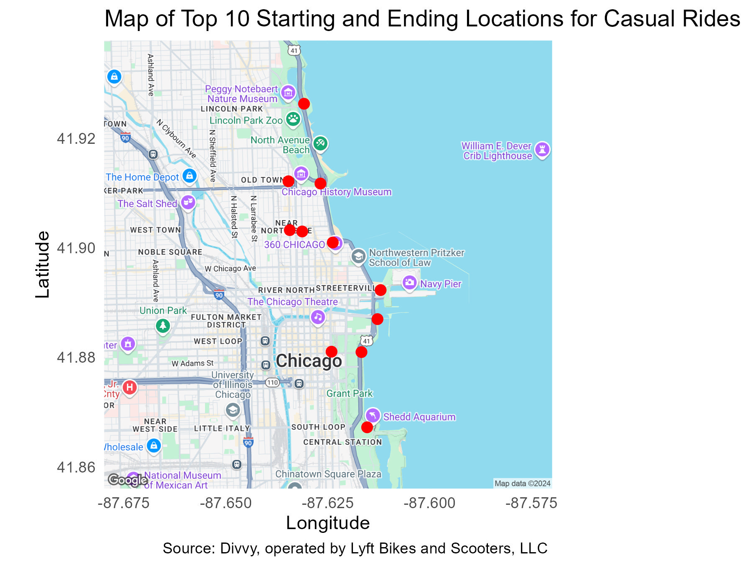
Solution 6 – ride locations (Casual)
Station Name | Start | End
Streeter Dr & Grand Ave | #1 | #1
DuSable Lake Shore Dr & North Blvd | #3 | #2
DuSable Lake Shore Dr & Monroe St | #2 | #3
Michigan Ave & Oak St | #4 | #4
Millennium Park | #6 | #5
Shedd Aquarium | #5 | #6
Theater on the Lake | #7 | #7
Dusable Harbor | #8 | #8
Wells St & Concord Ln | #9 | #9
Clark St & Elm St | #10
Wells St & Elm St |  | #10
Top 10 locations are around popular attractions.

Slide 18
Conclusions
The findings of each solution were that casual riders differ from member riders in the following criteria:
Ride length – Overall, casual riders take longer rides on average.
Day of the week – Casual riders ride more on the weekends, primarily Saturday. Member riders ride more during the week, primarily Wednesday. But both take the longest rides on Saturday on average.
Season of the year – Both casual and member riders ride more often and ride longer on average during summer. Next most popular is fall.
Month of the year – Both casual and member riders ride the most in September. But casual riders ride longer on average in July. Member riders ride longer on average in June.
Bike type – Both casual and member riders ride more often and ride longer on average on electric bikes. The next most popular are classic bikes.
Ride location – Casual rides started and ended the most around 11 key locations around Chicago’s downtown, particularly around popular attractions like Millennium Park, the Shedd Aquarium, Navy Pier, the Lincoln Park Zoo, the Chicago History Museum, Willis Tower (formerly the Sears Tower), the Art Institute, and the Modern Museum of Art. Member rides started and ended the most around 11 key locations around Chicago’s downtown as well but around popular commuting locations (like Union Station, the Ogilvie Transportation Center), universities (like Loyola University, the University of Chicago), and attractions (like the Chicago History Museum, the Diversey Driving Range).

Slide 19
Next steps
To encourage casual members to become annual members, a new marketing campaign could be constructed to entice a switch. From the data findings between annual and casual members, the marketing campaign should focus on the following areas:
Maximizes longer rides
Maximizes weekend rides
Maximizes primarily summer rides, particularly June – September
Maximizes rides on electric and classic bikes
Maximizes rides starting and ending around the key 11 identified spots (popular Chicago attractions)
Based on these findings, casual riders may be visitors checking out Chicago. The marketing campaign could also explore collaborating with tour packages, attraction packages, city explorer packages, and other tourist travel passes.

Slide 20
Thank you
Dana Anderson
dana.k.anderson88@gmail.com

Slide 21
Additional Information

Slide 22
Solution 1 – ride length
Rider Type | Minimum Ride Length (mins) | Maximum Ride Length (mins) | Average Ride Length (mins) | Median Ride Length (mins) | Mode Ride Length (mins) | 25th Quantile Ride Length (mins) | 75th Quantile Ride Length (mins) | IQR Ride Length (mins) | Standard Deviation Ride Length (mins) | Variance Ride Length (mins)
member | 1 | 34.98 | 10.5 | 8.53 | 4.92 | 5.15 | 13.96 | 8.81 | 7.11 | 50.52
casual | 1 | 34.98 | 12.66 | 10.67 | 6.3 | 6.45 | 17.35 | 10.9 | 7.92 | 62.78
There were a total of 5,357,670 records evaluated. 1,805,459 were casual. 3,552,211 were members.
Members have lower ride lengths for all three calculations: average, median, and mode ride lengths.
This means that
The average ride length of casual riders is longer.
The middle value of all casual ride lengths is higher.
The most common ride length for casual riders is higher.

Slide 23

Solution 2 – day of the week
 | Members |  | Casual
Day of the Week (Trip Start) | Average Ride Length (mins) | Number of Rides (n) | Average Ride Length (mins) | Number of Rides (n)
Sunday | 11.12 | 385,137 | 13.75 | 290,500
Monday | 10.14 | 502,825 | 12.13 | 210,848
Tuesday | 10.26 | 541,674 | 11.66 | 202,113
Wednesday | 10.4 | 598,504 | 11.86 | 238,748
Thursday | 10.28 | 574,124 | 11.81 | 240,810
Friday | 10.31 | 501,160 | 12.52 | 266,538
Saturday | 11.25 | 448,787 | 13.89 | 355,902
Overall | 10.5 | 3,552,211 | 12.66 | 1,805,459
Casual riders ride mostly on Saturdays. Their average ride length per day is longest on Saturdays.
Member riders ride mostly on Wednesdays. Their average ride length per day is longest on Saturdays.
Top hats represent the ‘top’ values!

Slide 24
Solution 2 – day of the week (MEmber)
Day of the Week (Member) | Minimum Ride Length (mins) | Maximum Ride Length (mins) | Average Ride Length (mins) | Median Ride Length (mins) | Mode Ride Length (mins) | 25th Quantile Ride Length (mins) | 75th Quantile Ride Length (mins) | IQR Ride Length (mins) | Standard Deviation Ride Length (mins) | Variance Ride Length (mins)
Sunday | 1 | 34.98 | 11.12 | 9.03 | 4.85 | 5.33 | 15.07 | 9.74 | 7.52 | 56.62
Monday | 1 | 34.98 | 10.14 | 8.17 | 4.92 | 4.97 | 13.35 | 8.38 | 6.95 | 48.32
Tuesday | 1 | 34.98 | 10.26 | 8.33 | 4.17 | 5.07 | 13.56 | 8.49 | 6.96 | 48.48
Wednesday | 1 | 34.98 | 10.4 | 8.49 | 5.07 | 5.15 | 13.79 | 8.64 | 7 | 49.06
Thursday | 1 | 34.98 | 10.28 | 8.38 | 4.68 | 5.09 | 13.62 | 8.53 | 6.93 | 48.04
Friday | 1 | 34.98 | 10.31 | 8.37 | 4.75 | 5.08 | 13.65 | 8.57 | 7 | 48.96
Saturday | 1 | 34.98 | 11.25 | 9.23 | 4.58 | 5.5 | 15.22 | 9.72 | 7.48 | 55.9

Slide 25
Solution 2 – day of the week (CASUAL)
Day of the Week (Casual) | Minimum Ride Length (mins) | Maximum Ride Length (mins) | Average Ride Length (mins) | Median Ride Length (mins) | Mode Ride Length (mins) | 25th Quantile Ride Length (mins) | 75th Quantile Ride Length (mins) | IQR Ride Length (mins) | Standard Deviation Ride Length (mins) | Variance Ride Length (mins)
Sunday | 1 | 34.98 | 13.75 | 11.975 | 7.78 | 7.17 | 19.09 | 11.92 | 8.24 | 67.84
Monday | 1 | 34.98 | 12.13 | 10.01 | 5.33 | 6.05 | 16.52 | 10.47 | 7.82 | 61.17
Tuesday | 1 | 34.98 | 11.66 | 9.63 | 5.02 | 5.94 | 15.64 | 9.7 | 7.49 | 56.06
Wednesday | 1 | 34.98 | 11.86 | 9.83 | 4.93 | 6.07 | 15.96 | 9.89 | 7.55 | 56.94
Thursday | 1 | 34.98 | 11.81 | 9.79 | 5.75 | 6.03 | 15.87 | 9.84 | 7.55 | 56.93
Friday | 1 | 34.98 | 12.52 | 10.52 | 6.4 | 6.39 | 17.07 | 10.68 | 7.86 | 61.82
Saturday | 1 | 34.98 | 13.89 | 12.14 | 7.77 | 7.32 | 19.3 | 11.98 | 8.24 | 67.87

Slide 26
Solution 3 – Season of the Year
 | Members |  | Casual
Season of the Year | Average Ride Length (mins) | Number of Rides (n) | Average Ride Length (mins) | Number of Rides (n)
Spring (Mar, Apr, May) | 10.45 | 826,969 | 12.83 | 363,368
Summer (Jun, Jul, Aug) | 11.21 | 1,197,056 | 13.48 | 763,139
Fall (Sep, Oct, Nov) | 10.18 | 1,082,923 | 11.92 | 567,795
Winter (Dec, Jan, Feb) | 9.43 | 445,263 | 10.28 | 111,157
Overall | 10.5 | 3,552,211 | 12.66 | 1,805,459
Both casual and member riders ride mostly in summer.
The average ride length per season for both casual and member riders is longest in summer.
Top hats represent the ‘top’ values!

Slide 27
Solution 3 – Season of the Year (member)
Season of the Year | Minimum Ride Length (mins) | Maximum Ride Length (mins) | Average Ride Length (mins) | Median Ride Length (mins) | Mode Ride Length (mins) | 25th Quantile Ride Length (mins) | 75th Quantile Ride Length (mins) | IQR Ride Length (mins) | Standard Deviation Ride Length (mins) | Variance Ride Length (mins)
Spring | 1 | 34.98 | 10.45 | 8.45 | 4.53 | 5.07 | 13.9 | 8.83 | 7.16 | 5.07
Summer | 1 | 34.98 | 11.21 | 9.3 | 5.67 | 5.59 | 15.05 | 9.46 | 7.34 | 5.59
Fall | 1 | 34.98 | 10.18 | 8.23 | 4.92 | 4.98 | 13.46 | 8.48 | 6.94 | 4.98
Winter | 1 | 34.98 | 9.43 | 7.53 | 4.65 | 4.68 | 12.23 | 7.55 | 6.57 | 4.68

Slide 28
Solution 3 – Season of the Year (Casual)
Season of the Year | Minimum Ride Length (mins) | Maximum Ride Length (mins) | Average Ride Length (mins) | Median Ride Length (mins) | Mode Ride Length (mins) | 25th Quantile Ride Length (mins) | 75th Quantile Ride Length (mins) | IQR Ride Length (mins) | Standard Deviation Ride Length (mins) | Variance Ride Length (mins)
Spring | 1 | 34.98 | 12.83 | 10.78 | 5.52 | 6.42 | 17.77 | 11.35 | 8.1 | 6.42
Summer | 1 | 34.98 | 13.48 | 11.69 | 6.95 | 7.16 | 18.48 | 11.32 | 8.02 | 7.16
Fall | 1 | 34.98 | 11.92 | 9.84 | 6.3 | 6 | 16.13 | 10.13 | 7.69 | 6
Winter | 1 | 34.98 | 10.28 | 8.2 | 4.7 | 5.15 | 13.33 | 8.18 | 7 | 5.15

Slide 29
Solution 4 – Month of the Year
 | Members |  | Casual
Month of the Year (Trip Start) | Average Ride Length (mins) | Number of Rides (n) | Average Ride Length (mins) | Number of Rides (n)
Jan | 9.02 | 113,666 | 9.23 | 22,478
Feb | 9.8 | 167,207 | 10.98 | 41,409
Mar | 9.79 | 207,534 | 11.93 | 70,235
Apr | 10.2 | 266,300 | 12.48 | 108,277
May | 11.03 | 353,135 | 13.38 | 184,856
Jun | 11.34 | 383,128 | 13.55 | 244,131
Jul | 11.25 | 402,403 | 13.58 | 257,447
Aug | 11.05 | 411,525 | 13.31 | 261,561
Sep | 10.49 | 449,449 | 12.13 | 295,363
Oct | 10.19 | 381,618 | 12.13 | 184,041
Nov | 9.6 | 251,856 | 10.79 | 88,391
Dec | 9.35 | 164,390 | 10.17 | 47,270
Overall | 10.5 | 3,552,211 | 12.66 | 1,805,459
Casual riders’ average ride length per month is longest in July. Member riders’ average ride length per month is longest in June.
Both casual riders and member riders ride mostly in September.
Top hats represent the ‘top’ values!

Slide 30
Solution 4 – Month of the Year (MEmber)
Month of the Year (Member) | Minimum Ride Length (mins) | Maximum Ride Length (mins) | Average Ride Length (mins) | Median Ride Length (mins) | Mode Ride Length (mins) | 25th Quantile Ride Length (mins) | 75th Quantile Ride Length (mins) | IQR Ride Length (mins) | Standard Deviation Ride Length (mins) | Variance Ride Length (mins)
Jan | 1 | 34.98 | 9.02 | 7.2 | 5.07 | 4.53 | 11.55 | 7.02 | 6.31 | 39.88
Feb | 1 | 34.98 | 9.8 | 7.83 | 4.25 | 4.82 | 12.82 | 8 | 6.79 | 46.13
Mar | 1 | 34.98 | 9.79 | 7.82 | 5 | 4.78 | 12.8 | 8.02 | 6.83 | 46.68
Apr | 1 | 34.98 | 10.2 | 8.18 | 3.57 | 4.93 | 13.5 | 8.57 | 7.06 | 49.87
May | 1 | 34.98 | 11.03 | 9.05 | 4.5 | 5.4 | 14.83 | 9.43 | 7.38 | 54.42
Jun | 1 | 34.98 | 11.34 | 9.44 | 5.32 | 5.66 | 15.24 | 9.58 | 7.38 | 54.44
Jul | 1 | 34.98 | 11.25 | 9.32 | 6.35 | 5.61 | 15.12 | 9.51 | 7.37 | 54.33
Aug | 1 | 34.98 | 11.05 | 9.14 | 5.58 | 5.51 | 14.81 | 9.3 | 7.27 | 52.86
Sep | 1 | 34.98 | 10.49 | 8.55 | 4.66 | 5.18 | 13.95 | 8.77 | 7.04 | 49.58
Oct | 1 | 34.98 | 10.19 | 8.25 | 4.45 | 4.97 | 13.49 | 8.52 | 6.96 | 48.44
Nov | 1 | 34.98 | 9.6 | 7.68 | 4 | 4.7 | 12.55 | 7.85 | 6.68 | 44.62
Dec | 1 | 34.98 | 9.35 | 7.47 | 4.6 | 4.67 | 12.13 | 7.46 | 6.49 | 42.13

Slide 31
Solution 4 – Month of the Year (CASUAL)
Month of the Year (Casual) | Minimum Ride Length (mins) | Maximum Ride Length (mins) | Average Ride Length (mins) | Median Ride Length (mins) | Mode Ride Length (mins) | 25th Quantile Ride Length (mins) | 75th Quantile Ride Length (mins) | IQR Ride Length (mins) | Standard Deviation Ride Length (mins) | Variance Ride Length (mins)
Jan | 1 | 34.98 | 9.23 | 7.38 | 4.92 | 4.78 | 11.6 | 6.82 | 6.35 | 40.29
Feb | 1 | 34.98 | 10.98 | 8.85 | 6.38 | 5.48 | 14.42 | 8.94 | 7.34 | 53.91
Mar | 1 | 34.98 | 11.93 | 9.7 | 5.7 | 5.82 | 16.33 | 10.51 | 7.87 | 61.95
Apr | 1 | 34.98 | 12.48 | 10.35 | 4.85 | 6.15 | 17.23 | 11.08 | 8.05 | 64.81
May | 1 | 34.98 | 13.38 | 11.5 | 6.37 | 6.87 | 18.53 | 11.66 | 8.17 | 66.7
Jun | 1 | 34.98 | 13.55 | 11.83 | 7.34 | 7.28 | 18.54 | 11.26 | 7.97 | 63.47
Jul | 1 | 34.98 | 13.58 | 11.77 | 8.13 | 7.19 | 18.68 | 11.49 | 8.09 | 65.43
Aug | 1 | 34.98 | 13.31 | 11.48 | 7.58 | 7.03 | 18.21 | 11.18 | 7.99 | 63.84
Sep | 1 | 34.98 | 12.13 | 10.11 | 5.39 | 6.14 | 16.49 | 10.35 | 7.74 | 59.85
Oct | 1 | 34.98 | 12.13 | 10.02 | 5.59 | 6.13 | 16.4 | 10.27 | 7.77 | 60.34
Nov | 1 | 34.98 | 10.79 | 8.65 | 4.12 | 5.38 | 14.25 | 8.87 | 7.25 | 52.58
Dec | 1 | 34.98 | 10.17 | 8.12 | 4.93 | 5.1 | 13.22 | 8.12 | 6.93 | 47.98

Slide 32
Solution 5 – Bike type
 | Members |  | Casual
Bike Type | Average Ride Length (mins) | Number of Rides (n) | Average Ride Length (mins) | Number of Rides (n)
Classic Bike | 10.94 | 1,705,183 | 14.34 | 768,792
Electric Bike | 10.13 | 1,791,264 | 11.51 | 959,042
Electric Scooter | 8.38 | 55,764 | 10.26 | 77,625
Overall | 10.5 | 3,552,211 | 12.66 | 1,805,459
Both casual and member riders ride more electric bikes than classic bikes or electric scooters.
Both casual and member riders have a higher average ride length with classic bikes over electric bikes and electric scooters.
Top hats represent the ‘top’ values!

Slide 33
Solution 5 – bike type (member)
Bike Type | Minimum Ride Length (mins) | Maximum Ride Length (mins) | Average Ride Length (mins) | Median Ride Length (mins) | Mode Ride Length (mins) | 25th Quantile Ride Length (mins) | 75th Quantile Ride Length (mins) | IQR Ride Length (mins) | Standard Deviation Ride Length (mins) | Variance Ride Length (mins)
Classic Bike | 1 | 34.98 | 10.94 | 8.76 | 4.92 | 5.25 | 14.67 | 9.42 | 7.52 | 56.58
Electric Bike | 1 | 34.98 | 10.13 | 8.38 | 4.1 | 5.08 | 13.46 | 8.38 | 6.7 | 44.88
Electric Scooter | 1 | 34.98 | 8.38 | 6.82 | 3.57 | 4.3 | 10.91 | 6.61 | 5.66 | 32.03

Slide 34
Solution 5 – bike type (Casual)
Bike Type | Minimum Ride Length (mins) | Maximum Ride Length (mins) | Average Ride Length (mins) | Median Ride Length (mins) | Mode Ride Length (mins) | 25th Quantile Ride Length (mins) | 75th Quantile Ride Length (mins) | IQR Ride Length (mins) | Standard Deviation Ride Length (mins) | Variance Ride Length (mins)
Classic Bike | 1 | 34.98 | 14.34 | 12.62 | 7.6 | 7.71 | 19.87 | 12.16 | 8.28 | 68.58
Electric Bike | 1 | 34.98 | 11.51 | 9.52 | 6.4 | 5.85 | 15.44 | 9.59 | 7.43 | 55.2
Electric Scooter | 1 | 34.98 | 10.26 | 8.24 | 6.06 | 5.11 | 13.46 | 8.35 | 7.01 | 49.08

Slide 35
Solution 6 – Top 10 Start Stations (member)
# | Station Name | Number of Rides (n) | Latitude | Longitude
1 | Kingsbury St & Kinzie St | 28,688 | 41.8892 | -87.639
2 | Clinton St & Washington Blvd | 27,568 | 41.8834 | -87.641
3 | Clinton St & Madison St | 24,205 | 41.8828 | -87.641
4 | Clark St & Elm St | 23,837 | 41.9325 | -87.632
5 | Wells St & Concord Ln | 20,424 | 41.9121 | -87.635
6 | Wells St & Elm St | 20,003 | 41.9032 | -87.634
7 | Clinton St & Jackson Blvd | 19,469 | 41.8783 | -87.641
8 | State St & Chicago Ave | 18,531 | 41.8966 | -87.629
9 | University Ave & 57th St | 18,218 | 41.7915 | -87.6
10 | Dearborn St & Erie St | 17,945 | 41.894 | -87.629
Note: There were 617,476 member rides without start station names. This accounted for 0.1738 (17.38%) of all casual data and 0.1153 (11.53%) of the final data set.

Slide 36
Solution 6 – Top 10 end Stations (member)
# | Station Name | Number of Rides (n) | Latitude | Longitude
1 | Kingsbury St & Kinzie St | 28,886 | 41.8892 | -87.639
2 | Clinton St & Washington Blvd | 28,592 | 41.8834 | -87.641
3 | Clinton St & Madison St | 25,605 | 41.8828 | -87.641
4 | Clark St & Elm St | 24,072 | 41.9325 | -87.632
5 | Wells St & Concord Ln | 20,627 | 41.9121 | -87.635
6 | Wells St & Elm St | 19,955 | 41.9032 | -87.634
7 | Clinton St & Jackson Blvd | 19,876 | 41.8783 | -87.641
8 | State St & Chicago Ave | 19,265 | 41.8966 | -87.629
9 | University Ave & 57th St | 18,653 | 41.7915 | -87.6
10 | Canal St & Madison St | 17,961 | 41.8824 | -87.64
Note: There were 593,251 member rides without end station names. This accounted for 0.1670 (16.70%) of all casual data and 0.1107 (11.07%) of the final data set.

Slide 37
Solution 6 – Top 10 Start Stations (Casual)
# | Station Name | Number of Rides (n) | Latitude | Longitude
1 | Streeter Dr & Grand Ave | 33,370 | 41.892 | -87.612
2 | DuSable Lake Shore Dr & Monroe St | 22,197 | 41.881 | -87.617
3 | DuSable Lake Shore Dr & North Blvd | 18,071 | 41.912 | -87.627
4 | Michigan Ave & Oak St | 16,198 | 41.901 | -87.624
5 | Shedd Aquarium | 15,707 | 41.867 | -87.615
6 | Millennium Park | 14,618 | 41.881 | -87.624
7 | Theater on the Lake | 12,856 | 41.926 | -87.631
8 | Dusable Harbor | 12,624 | 41.887 | -87.613
9 | Wells St & Concord Ln | 10,464 | 41.912 | -87.635
10 | Clark St & Elm St | 9,844 | 41.903 | -87.631
Note: There were 352,648 casual rides without start station names. This accounted for 0.1953 (19.53%) of all casual data and 0.0658 (6.58%) of the final data set.

Slide 38
Solution 6 – Top 10 End Stations (Casual)
# | Station Name | Number of Rides (n) | Latitude | Longitude
1 | Streeter Dr & Grand Ave | 35,330 | 41.892 | -87.612
2 | DuSable Lake Shore Dr & North Blvd | 20,292 | 41.912 | -87.627
3 | DuSable Lake Shore Dr & Monroe St | 19,819 | 41.881 | -87.617
4 | Michigan Ave & Oak St | 16,691 | 41.901 | -87.624
5 | Millennium Park | 16,427 | 41.881 | -87.624
6 | Shedd Aquarium | 14,136 | 41.867 | -87.615
7 | Theater on the Lake | 12,674 | 41.926 | -87.631
8 | Dusable Harbor | 11,020 | 41.887 | -87.613
9 | Wells St & Concord Ln | 10,415 | 41.912 | -87.635
10 | Wells St & Elm St | 9,578 | 41.903 | -87.634
Note: There were 376,423 casual rides without end station names. This accounted for 0.2085 (20.85%) of all casual data and 0.0703 (7.03%) of the final data set.

Slide 39
Appendices

Slide 40
The Data
Cyclistic's data was housed by the cloud computing platform, Amazon Web Services (AWS), located at the following address (https://divvy-tripdata.s3.amazonaws.com/index.html).
The datasets of the most recent 12 months (November 2023 - October 2024) were downloaded and stored.
The data was
R: Reliable. The data contained large, complete amounts of data for each month. The data was also unbiased as it contained no customer information, only ride information.
O: Original. The first party data came from the bike sharing system, Divvy, which is a program of the Chicago Department of Transportation (CDOT) and operated by Lyft Bikes and Scooters, LLC (“Bikeshare”).
C: Comprehensive. The data contained all information needed to compare member riders and casual riders, based on rides alone.
C: Current. The most recent 12 months of data were gathered for this analysis.
C: Cited. The data was vetted by being first party data, gathered from a clearly identifiable source. In order to get further proof of the data being vetted, I contacted the data team at Lyft myself to see if there were any additional information. Their support representative stated, “Our internal teams and external partners review and verify the published data to ensure accurate and correct reporting.”

Slide 41
The Data
Licensing – The data was allowed to be analyzed through a license, located at the following address (https://divvybikes.com/data-license-agreement).
Privacy and Security – The data contained zero personal information and zero financial information related to the customers. All ride IDs were listed as 16-character identifiers. There was no way to link the data to actual people.
Accessibility – The data is publicly available, free for anyone to use, as long as adherence to the license is met. It can be accessed from Divvy’s cloud platform at anytime. The datasets used for this analysis were gathered from that cloud platform and stored on a PC.
Integrity – The integrity of the data was determined by myself, through inspecting the data and performing data cleaning. I found the data to have little issues and had mostly uniform content.
Credibility – Upon contacting Lyft directly about their data, they stated, “Our internal teams and external partners review and verify the published data to ensure accurate and correct reporting.” With the license provided, the privacy and security ensured, and their official response for further information regarding being vetted and cited, I considered this first-party data to be credible.
Problems – No problems were found while interacting with the data, apart from general data cleaning tasks such as converting data types and removing missing values.

Slide 42
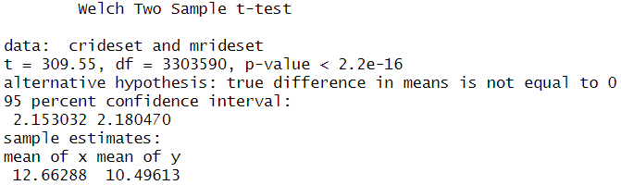
The Data
What steps have you taken to ensure that your data is clean? How can you verify that your data is clean and ready to analyze?
Each column (field) of the data set was inspected and evaluated for consistency and completeness and all identified anomalies were removed. Since there is no standard value to measure against, accuracy was not evaluated.
Since I also evaluated the entire population of the dataset and not a sample, I did not perform a test for confidence interval or margin of error. However, a t-test was performed on the final data set of ride lengths of casual and member riders to test for statistical significance. p = 0.00000000000000022. Therefore, I rejected the null hypothesis and accepted the alternative. The data sets were statistically different from each other. This means that casual riders did have statistically different ride lengths than member riders.

Slide 43
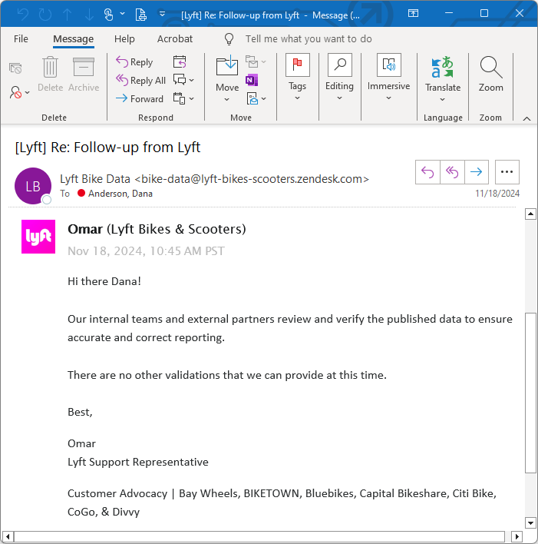

Lyft correspondence

Slide 44
Sources and Tools
Data was sourced from Divvy and downloaded as CSV files.
Analysis was performed using R language in RStudio (desktop).
R was chosen as the selected programming language because it is one of the most common languages used for data analysis. It was also the selected language of the Google Data Analytics Professional Certificate.
RStudio (desktop) was chosen as the selected program because it is the most common program to use when performing data analysis using R, apart from the base R program. RStudio also provides a better environment and more support for learners. The desktop version was used over the web-based version because the web-based version didn’t have the capacity to analyze the large amount of data under it’s free-to-use designation.

Slide 45
Data Dictionary
ride_id (character) – 16-character identifier for each ride
rideable_type (character) – 3 options: classic_bike, electric_bike, and electric_scooter
started_at (character) – date and time of when the ride started, format YYYY-MM-DD HH:MM:SS
ended_at (character) – date and time of when the ride ended, format YYYY-MM-DD HH:MM:SS
start_station_name (character) – name of the station, 1767 different stations
start_station_id (character) – ID of the station, 1725 different IDs
end_station_name (character) – name of the station, 1780 different stations
end_station_id (character) – ID of the station, 1732 different IDs
start_lat (numerical) – the latitude coordinate of the starting location, format ##.##/-##.##
start_lng (numerical) – the longitude coordinate of the starting location, format ##.##/-##.##
end_lat (numerical) – the latitude coordinate of the ending location, format ##.##/-##.##
end_lng (numerical) – the longitude coordinate of the ending location, format ##.##/-##.##
member_casual (character) – 2 options: casual, member

Slide 46
Object Dictionary – Part 1
bikedata (octdata, sepdata, augdata, juldata, jundata, maydata, aprdata, mardata, febdata, jandata, decdata, novdata)
bdnewna
bdnew
bdfinal → ride_length_plot (solution #1), ride_type_plot (solution #5a)
ride_stats (solution #1)
dotw_stats1
dotw_stats2 → week_length_plot (solution #2a)
dotw_stats3 → week_num_plot (solution #2b)
soty_stats1
soty_stats2 → season_length_plot (solution #3a)
soty_stats3 → season_num_plot (solution #3b)
moty_stats1
moty_stats2 → month_length_plot (solution #4a)
moty_stats3 → month_num_plot (solution #4b)
type_stats1
type_stats2 → type_num_plot (solutions #5b)

Slide 47
Object Dictionary – Part 2
bdfinal
casualset
crideset → casualridemode
cdayset1 → casualdaymode
cdayset2
cdotw_stats (solution #2a)
cseasonset1 → casualseasonmode
cseasonset2
csoty_stats (solution #3a)
cmonthset1 → casualmonthmode
cmonthset2
cmoty_stats (solution #4a)
ctypeset1 → casualtypemode
ctypeset2
ctype_stats (solution #5a)
top_ten_cas → top_ten_cstart (solution #6b)
top_ten_cae → top_ten_cend (solution #6b)
top_ten_cstart + top_ten_cend → top_ten_overallc (solution #6b)
bdfinal
memberset
mrideset → memberridemode
mdayset1 → memberdaymode
mdayset2
mdotw_stats (solution #2a)
mseasonset1 → memberseasonmode
mseasonset2
msoty_stats (solution #3a)
mmonthset1 → membermonthmode
mmonthset2
mmoty_stats (solution #4a)
mtypeset1 → membertypemode
mtypeset2
mtype_stats (soluction #5a)
top_ten_mas → top_ten_mstart (solution #6a)
top_ten_mae → top_ten_mend (solution #6a)
top_ten_mstart + top_ten_mend → top_ten_overallm (solution #6a)

Slide 48
Data Cleaning/Transformation Documentation
Merged the 12 months of data into a single dataframe. The full data set contained 5,933,712 records.
Identified the variables. Identified general characteristics of each variable, like type, minimum value, maximum value, minimum length, and maximum length. Looked for missing, null, and NA values.
Removed the start_station_name, start_station_id, end_station_name, and end_station_id columns as they each had over 1 million blank values. I also felt that they didn’t add value to the analysis since I wasn’t looking at the location identifiers for this analysis.
Removed 7,417 rows (records) because of the NA values in the End Latitude and End Longitude variables. This accounted for 0.00125 (0.125%) of the data.
Converted the started_at column and the ended_at column into Date Time.
Calculated the trip length by subtracting the started_at column from the ended_at column and dispensed the result in a new column, ride_length. Converted the results from seconds to minutes.
Removed 258 rows (records) of start dates and end dates that were swapped, creating negative trip lengths. This accounted for 0.0000435 (0.00435%) of the data.
Removed 134,526 rows (records) where the ride length was less than 1 min (60 secs). Divvy stated that all data was screened for trips that were less than 60 seconds because of user error (riders cancelling trips, etc). This accounted for 0.0227 (2.27%) of the data.

Slide 49
Data Cleaning/Transformation Documentation
Determined what was considered an outlier (433,841 records). This accounted for 0.0728 (7.28%) of the data. Removed them.
A total of 576,042 rows (records) were removed from the original data set (5,933,712 records), which accounted for 0.0971 (9.71%) of the data. The resulting data set used for calculations was 5,357,670 records.
Calculated the days of the week for date and time each trip started and dispensed the results in a new column, dotw_start.
Calculated the month of the year for date and time each trip started and dispensed the results in a new column, moty_start.
Calculated the season of the year for date and time each trip started and dispensed the results in a new column, soty_start.

